Slide 1
Matrix Multiplication using MapReduce

Slide 2
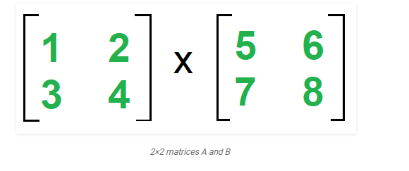
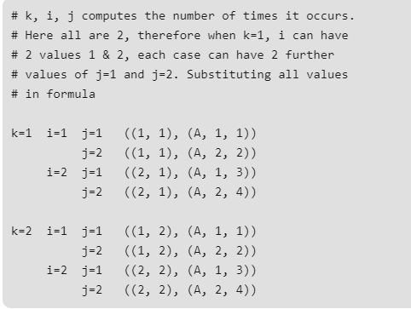


Slide 3
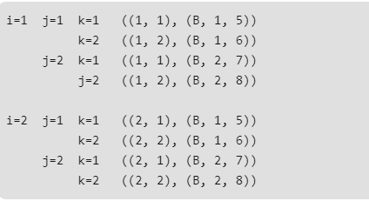

Slide 4
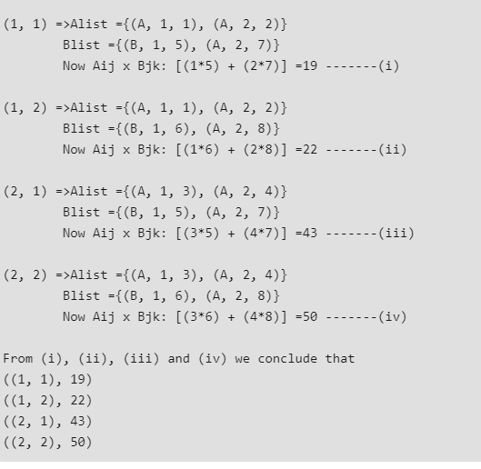
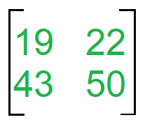
Reducer
Reducer(k, v)=(i, k)=>Make sorted Alist and Blist (i, k) => Summation (Aij * Bjk)) for j Output =>((i, k), sum)

Slide 5
